Slide 1



Exploring High-Energy Atmospheric Muons with IceCube: Unfolding the Muon Flux
Pascal Gutjahr
DPG Frühjahrstagung in Göttingen | April 4, 2025
Source: NASA

Slide 2
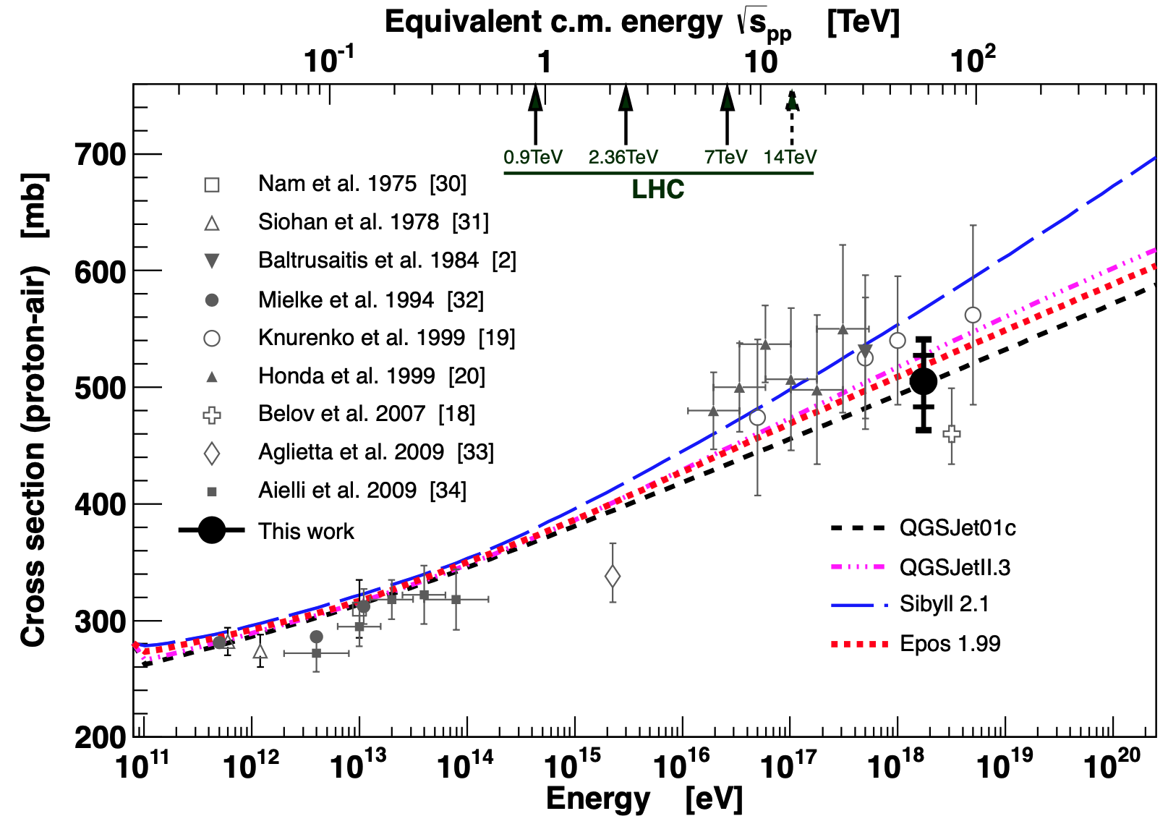
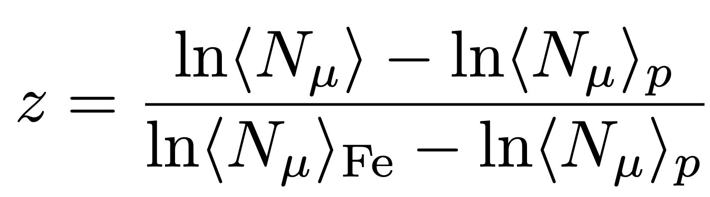
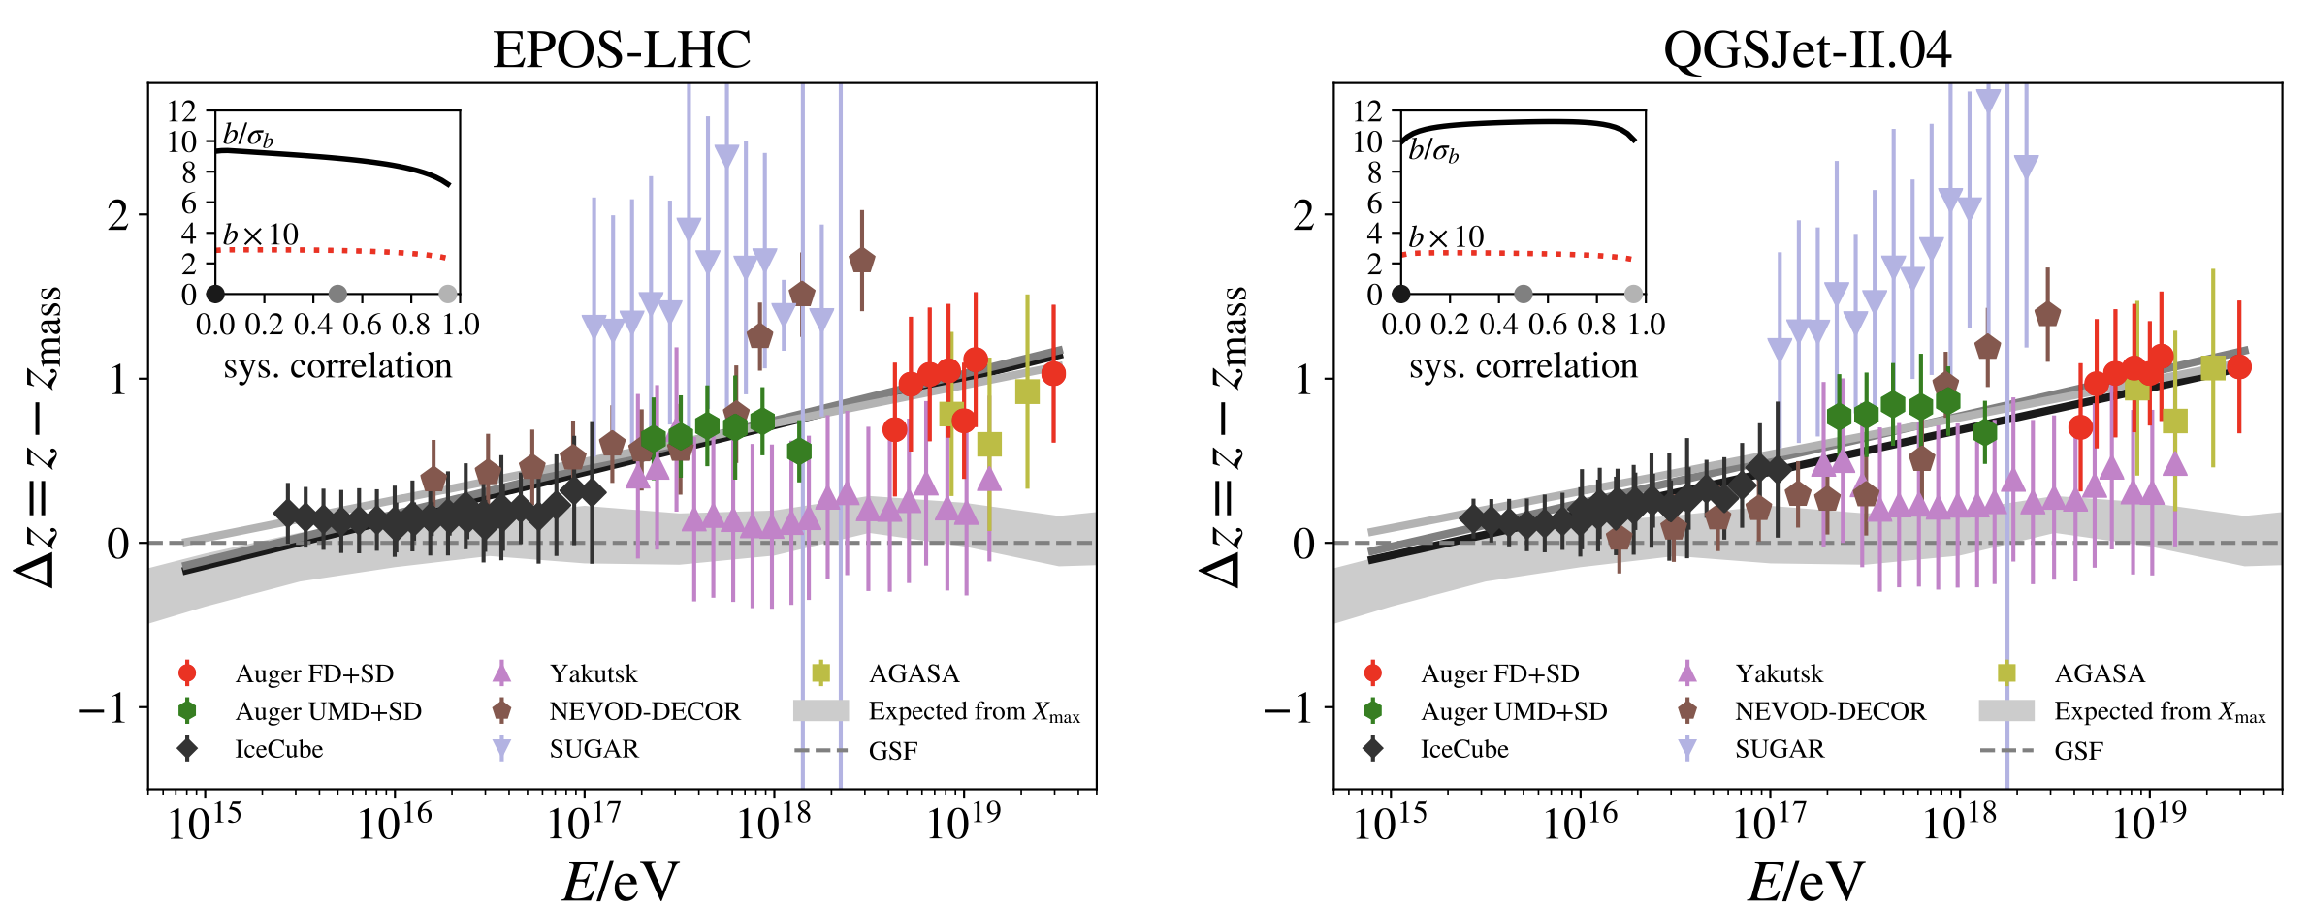
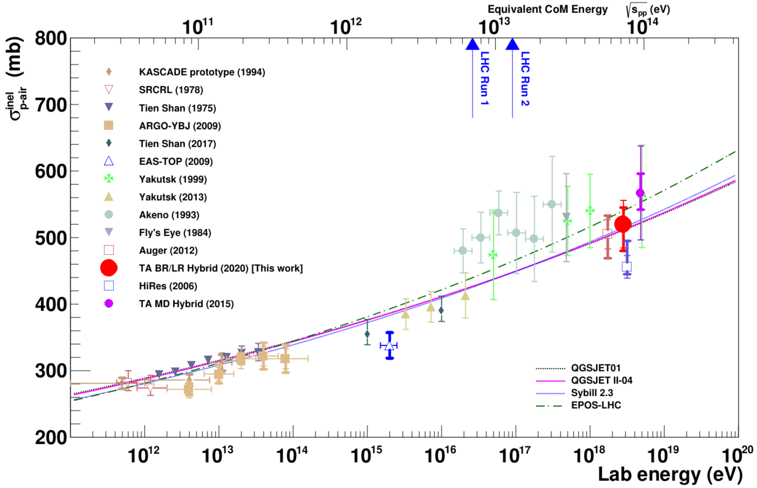
Muon Puzzle & Hadronic Uncertainties
”muon number”
Expected z
(“muon number”)
2012
2108.08341
1208.1520
Uncertainties at E > 10 PeV
2020
More muons measured than simulated for E > 40 PeV ~ cms 8 TeV
Precise pion/kaon ratio measurement needed
2006.05012

Slide 3

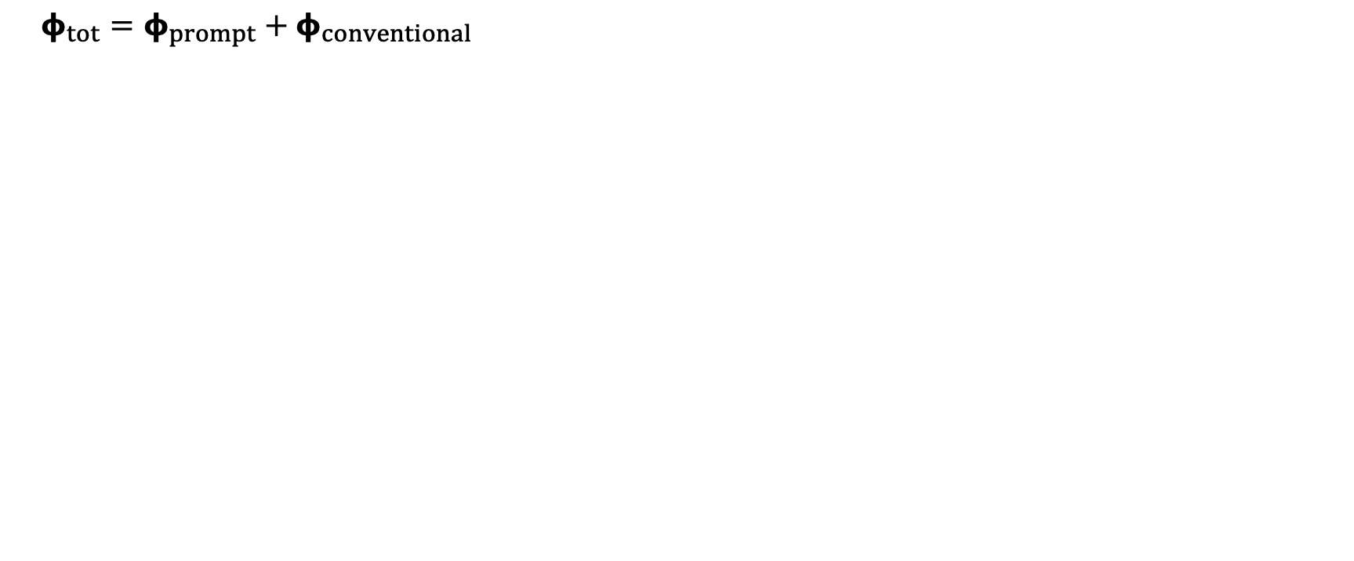
Muon Flux
Most energetic muon in bundle
Muon parent:
pion or kaon
yes
no
$φ_{tot}=φ_{prompt}+$ $φ_{conventional}$
conventional
prompt
Credit: Ludwig Neste
Notes:
gamma = 2.7: SNR → fermi/shock acceleration, propagation of cosmic rays lead to interactions with galactic magnetic fields, interactions with gas, energy losses (ionization and nuclear interactions), in this process, some cosmic rays can escape the magnetic fields → this rate is energy dependent → higher-energtic cosmic rays escape more quickly → steepening of spectrum to ~2.7

Slide 4
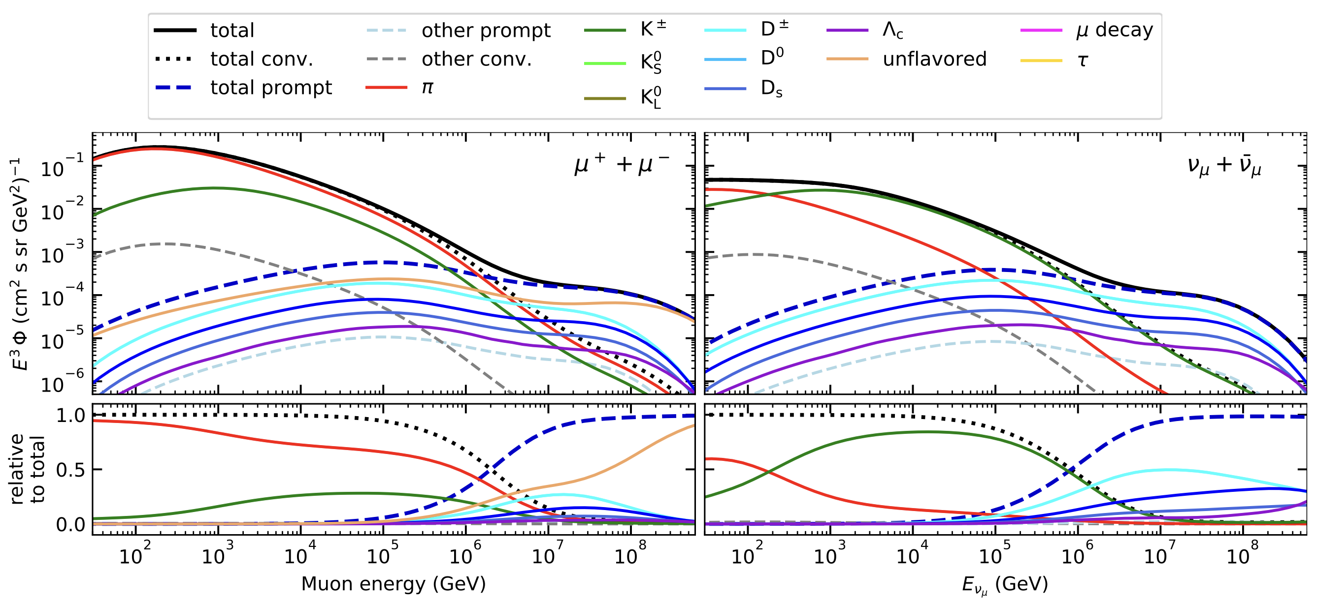
Prompt Atmospheric Muons & Neutrinos
10.1103/PhysRevD.100.103018
no unflavored
dominated by pions
dominated by kaons
Combined fit:
handle on pion/kaon ratio
handle on charmed mesons

Slide 5
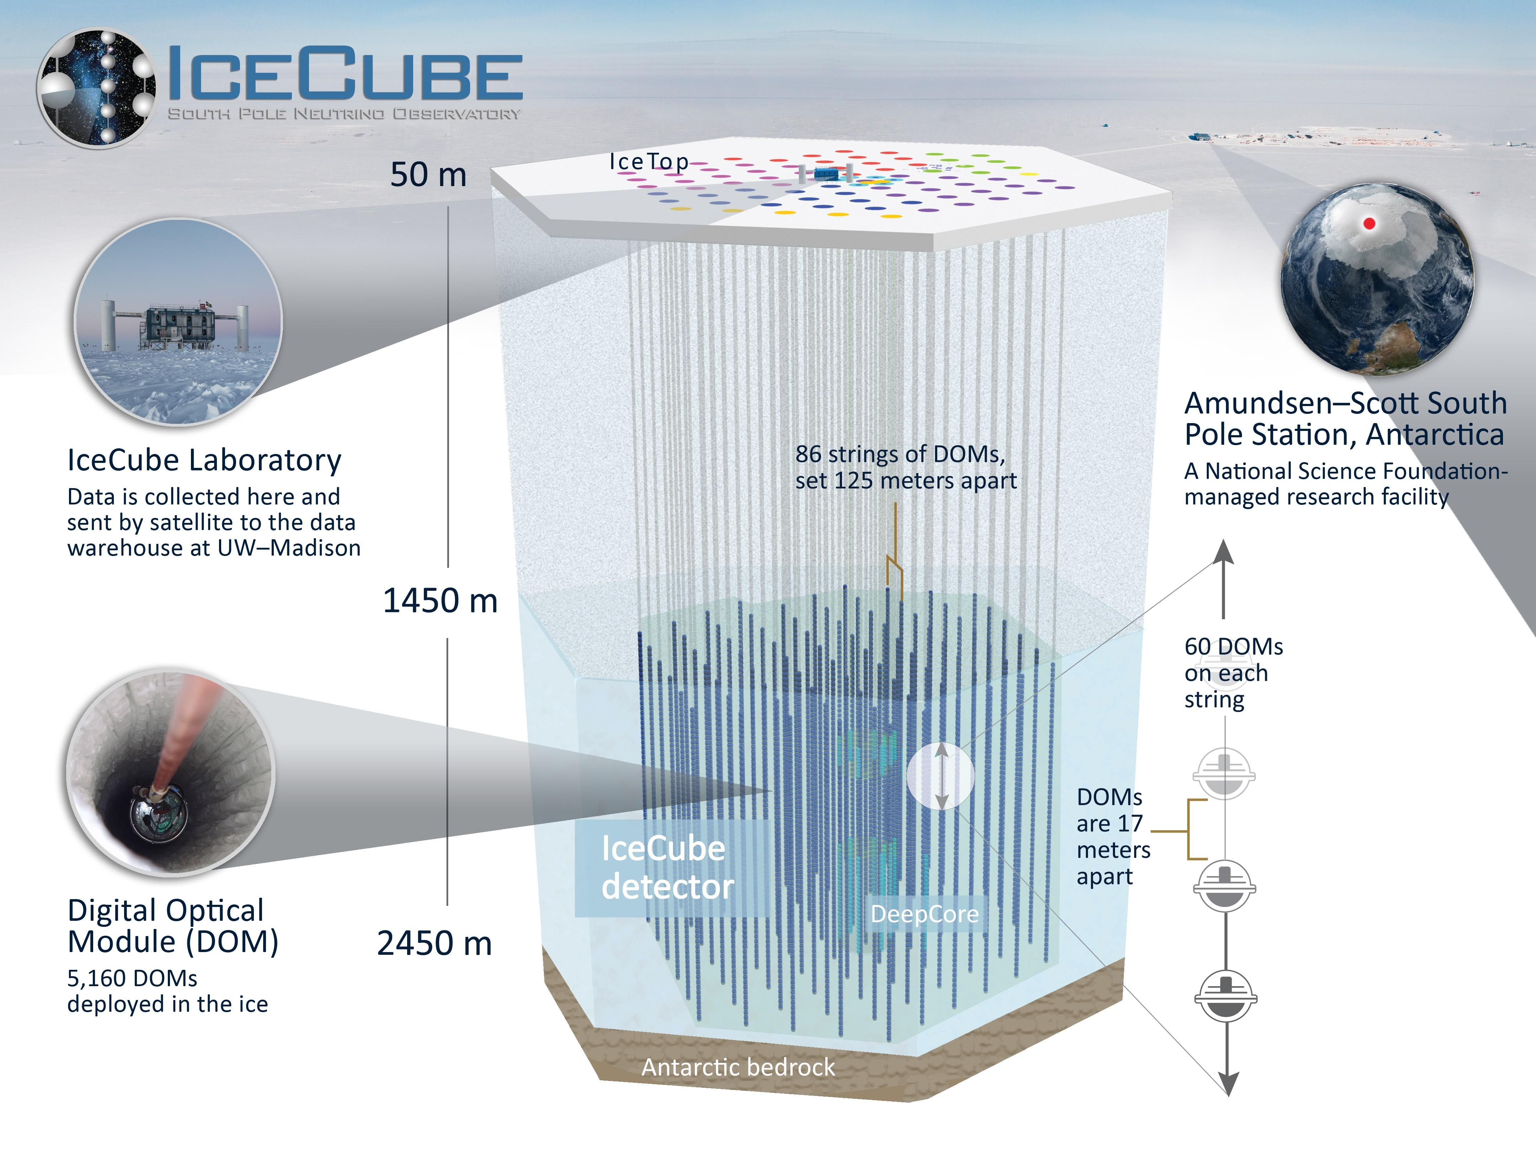
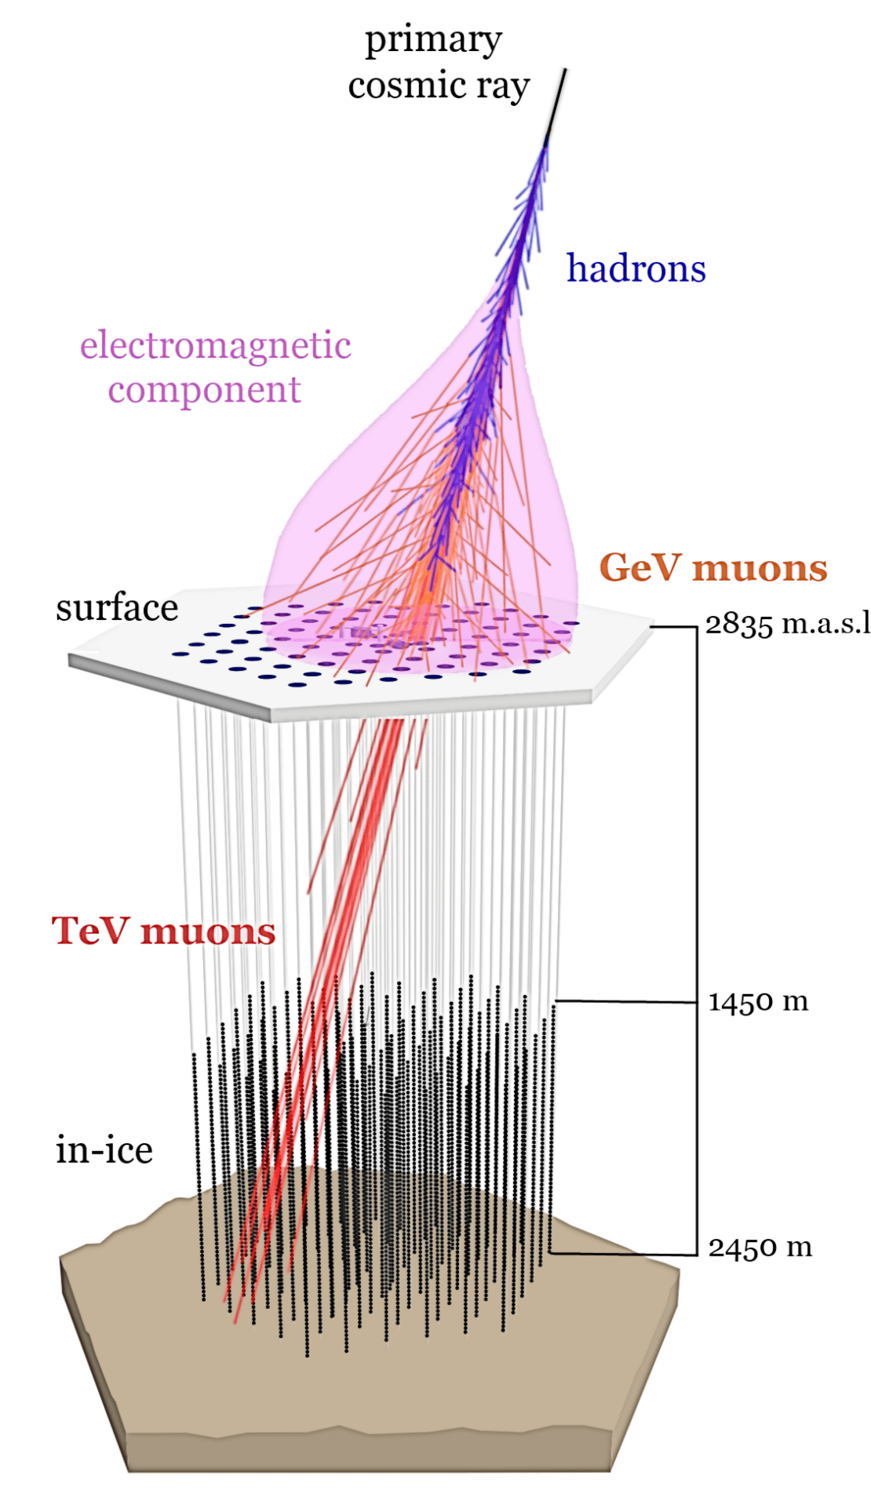
icecube.wisc.edu/science/research
icecube.wisc.edu/science/icecube

Slide 6
Overview
Analysis
Simulation
Reconstruction
Selection
Forward fit
Dataset
CORSIKA 77500 Ehist
SIBYLL 2.3d
10 TeV – 100 EeV
DNN reconstructions
Muon energies
Muon direction
Track geometry
Level 3
L2 muon filter
500 TeV bundle energy cut at surface
Add labels
Fit prompt normalization
Poisson LLH fit
Validation
Tag prompt / conv particles
MCEq comparisons
Unfolding
Level 4
Add DNN reconstructions
Muon spectrum
Unfold muon flux
Level 5
Data-MC quality cuts

Slide 7

Simulation

Slide 8
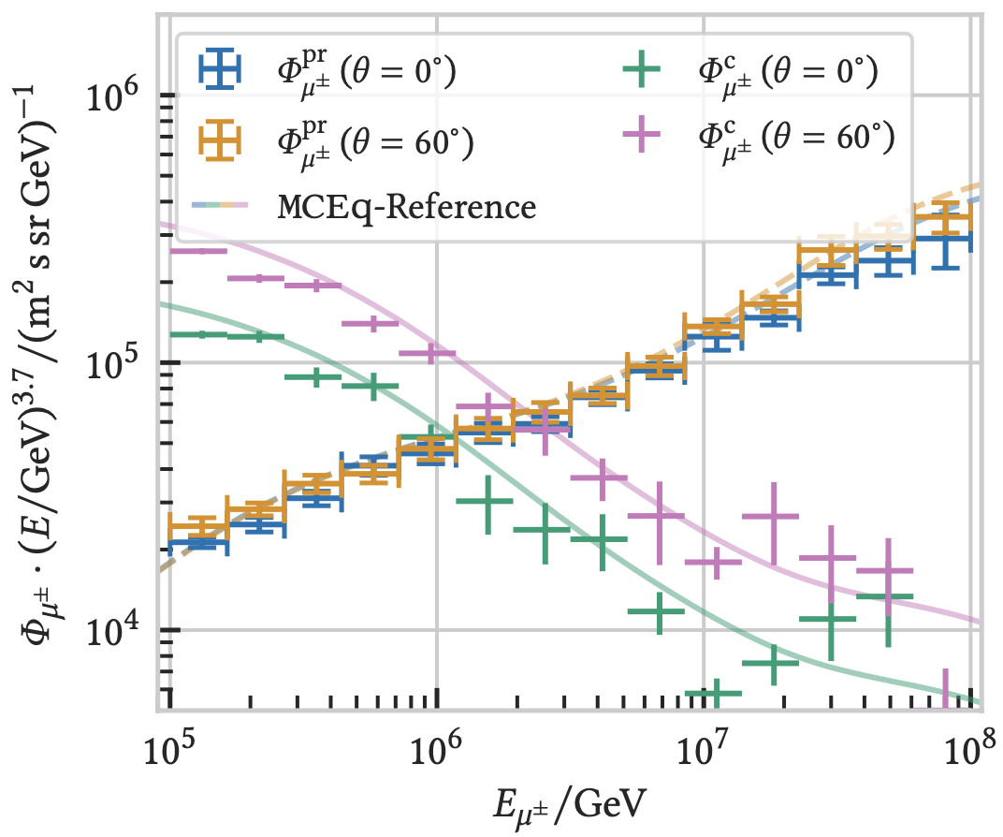

CORSIKA 7 vs. MCEq
MCEq: tool to numerically solve the cascade equations that describes the evolution of particle densities as they propagate through a gaseous, dense medium
https://github.com/mceq-project/MCEq
Good agreement for inclusive flux
Python package developed – PANAMA
Execute CORSIKA 7 (multi core)
Read DAT files → pandas DataFrames
Parse EHIST option
Calculate primary weightings
https://github.com/The-Ludwig/PANAMA
https://arxiv.org/pdf/2502.10951

Slide 9
DNN Reconstructions

Slide 10
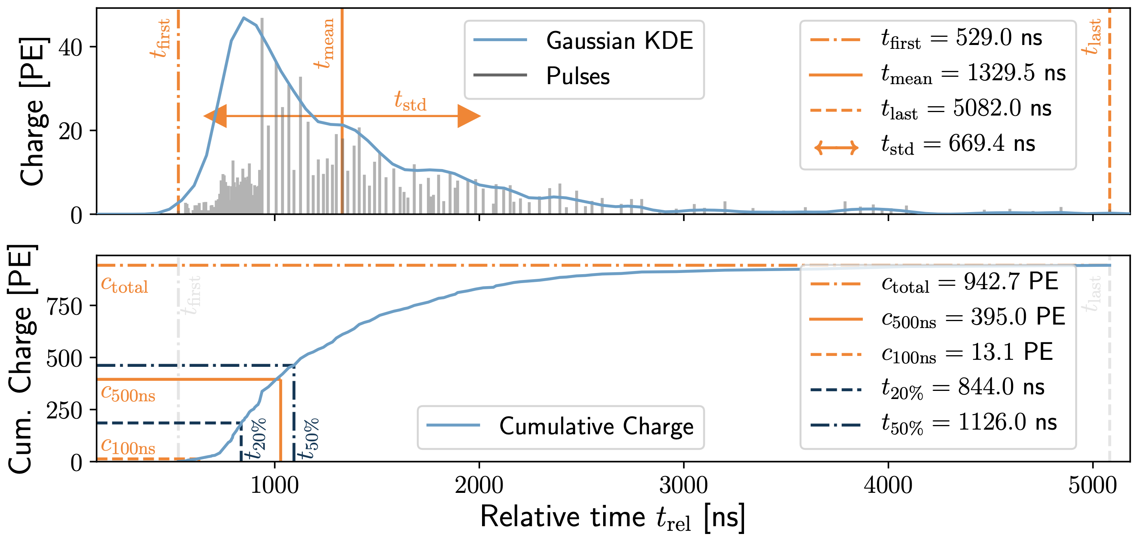
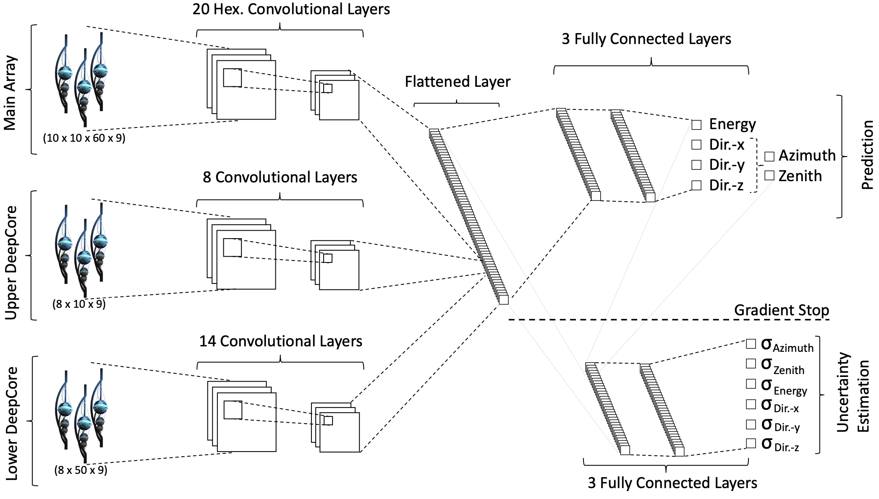
Convolutional Neural Network (CNN)
10.1088/1748-0221/16/07/P07041
Reconstruct:
Energy
muon / bundle energy at entry
Direction
zenith / azimuth
Geometry
detector entry / depth
2101.11589

Slide 11
Bundle energy at entry – 6 µs cleaned pulses
Median + 90% quantile
Prediction
True

Slide 12
Leading muon energy at entry – 6 µs cleaned pulses
Median + 90% quantile
Prediction
True

Slide 13
Unfolding

Slide 14
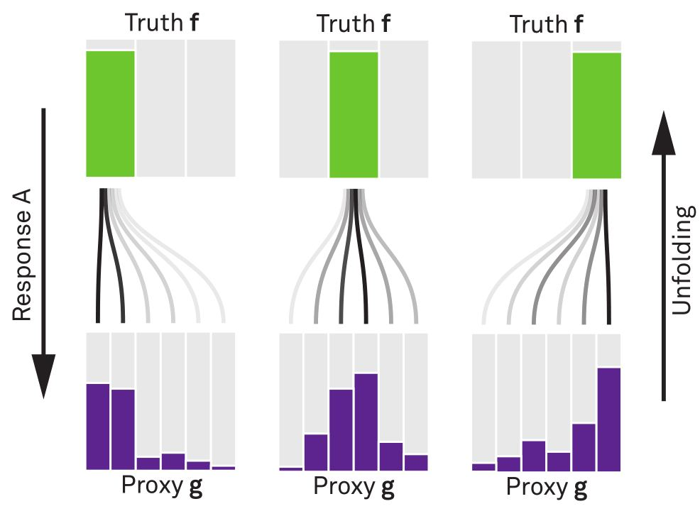


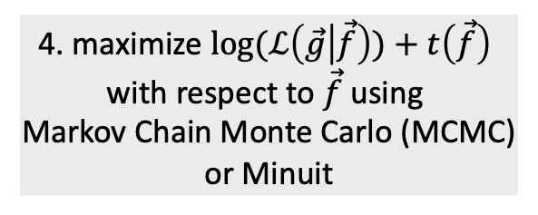
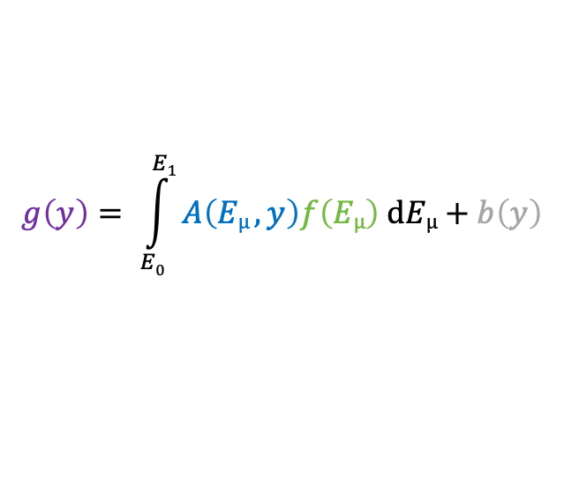
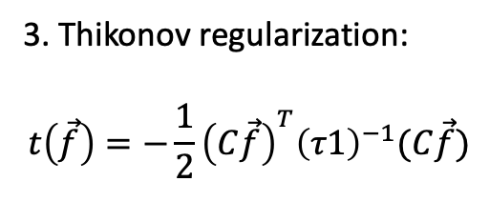
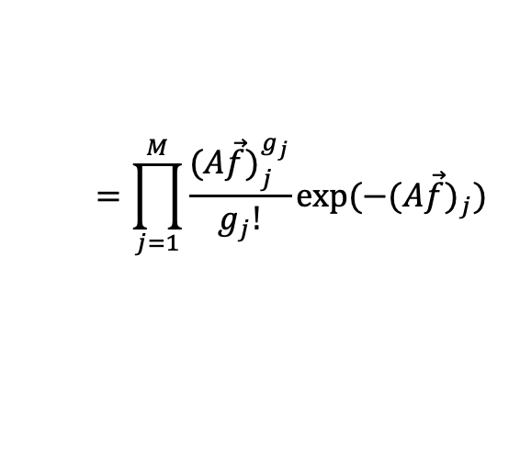
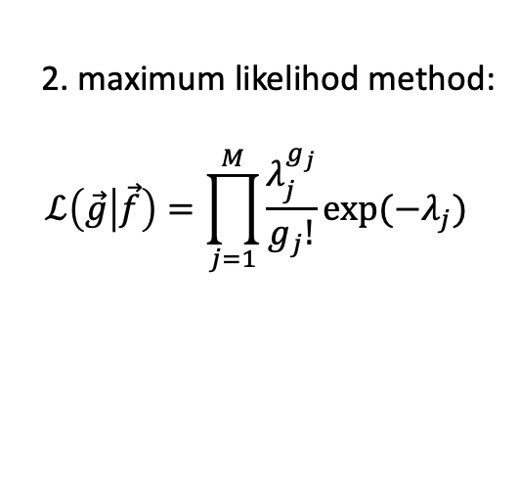
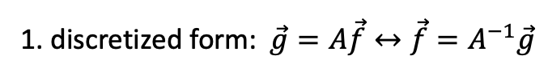
Unfolding in a Nutshell
folding
unfolding
measured proxy
detector response
background
1. discretized form: $\vec{g}=A\vec{f}↔\vec{f}=A^{−1}\vec{g}$
$$g\left(y\right)= \int_{E0}^{E1}{A\left(Eµ , y\right)f\left(Eµ\right) dEµ+b\left(y\right) }$$
2. maximum likelihod method:
$$ℒ\left(\vec{g} | \vec{f}\right)=\prod_{j=1}^{M}{\frac{λ_{j}^{g_{j}}}{g_{j}!}exp⁡(−λ_{j})}$$
3. Thikonov regularization:
$$t\left(\vec{f}\right)=−\frac{1}{2}{\left(C\vec{f}\right)}^{T}{\left(τ1\right)}^{−1}(C\vec{f})$$
true energy distribution
$$=\prod_{j=1}^{M}{\frac{{(A\vec{f})}_{j}^{g_{j}}}{g_{j}!}exp⁡(−{(A\vec{f})}_{j})}$$
funfolding
by M. Börner
4. maximize $log⁡(ℒ\left(\vec{g} | \vec{f}\right))+t\left(\vec{f}\right)$
with respect to $\vec{f}$ using
Markov Chain Monte Carlo (MCMC)
or Minuit
Credit: T. Hoinka

Slide 15
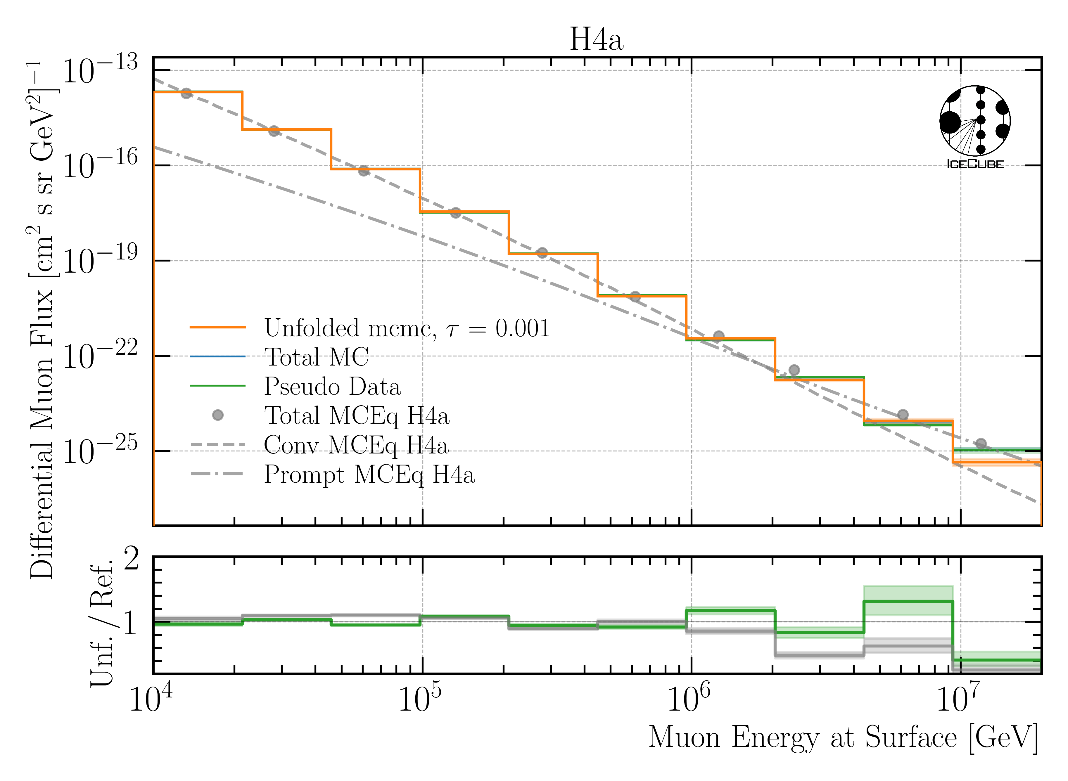
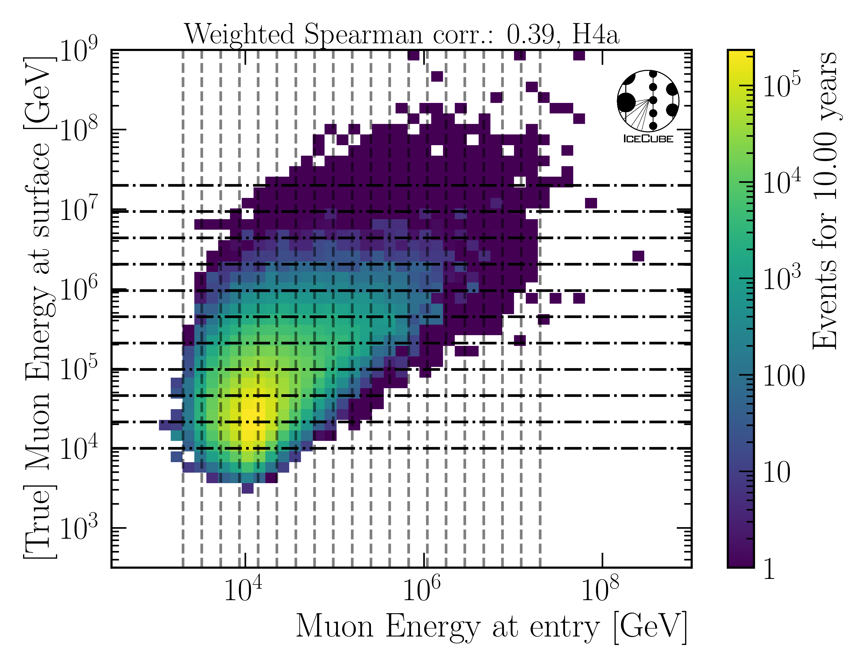
Unfolded Muon Flux at Surface
MC only
IceCube
Preliminary
IceCube Preliminary

Slide 16
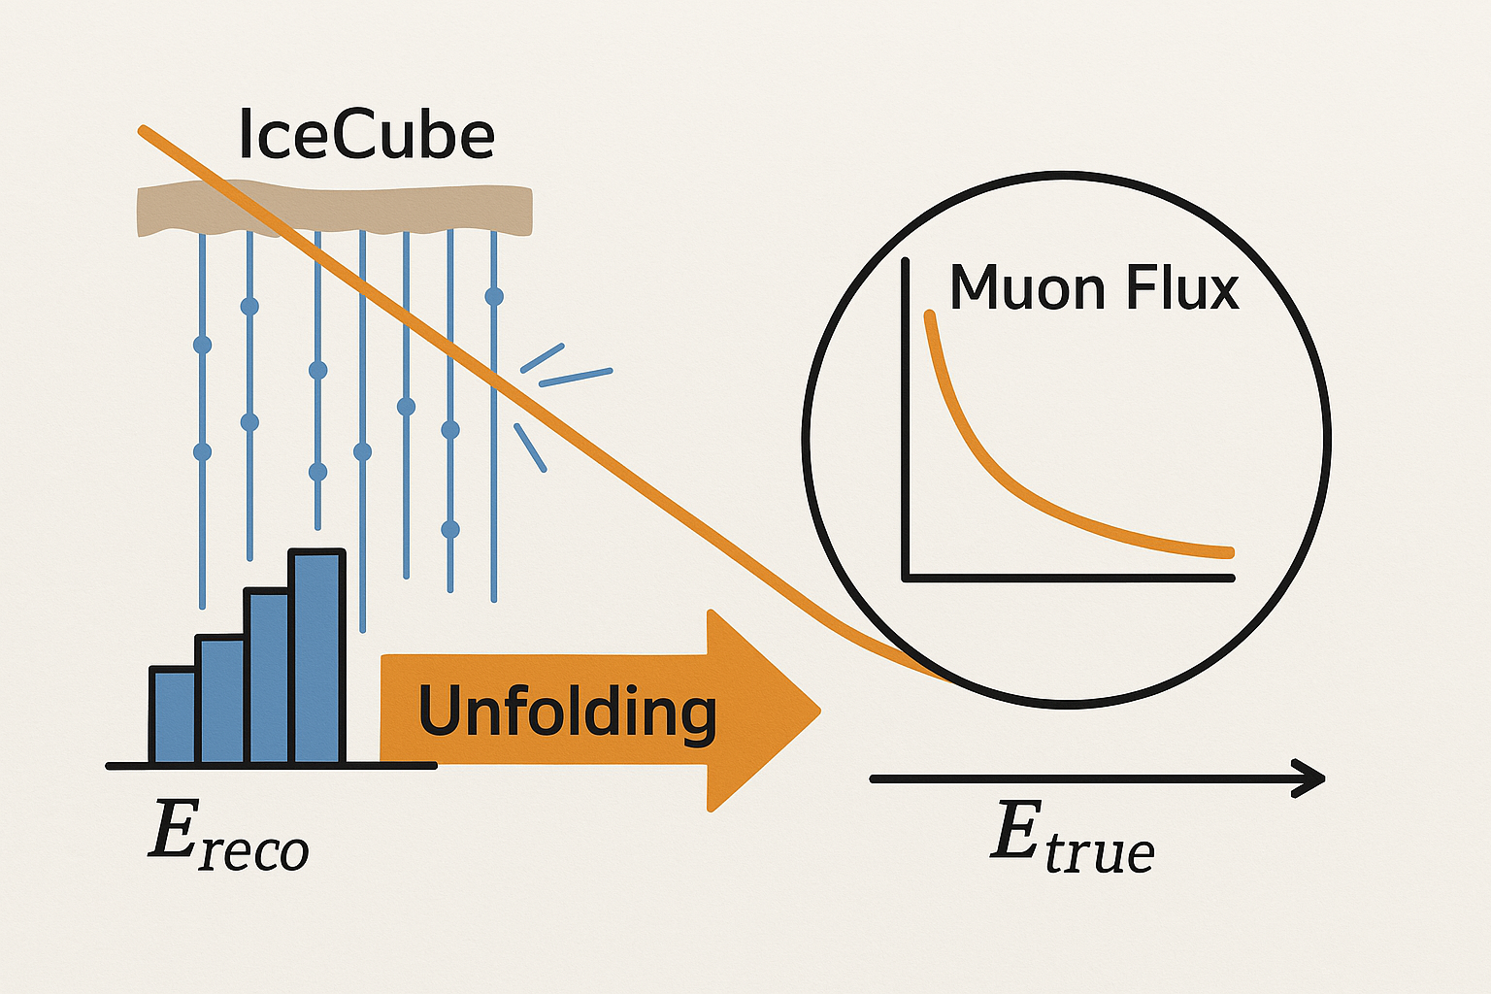
Conclusion & Outlook
New CORSIKA simulations with parent information
Tag prompt and conventional muons
Validation: agreement with MCEq
arXiv: 2502.10951
github.com/The-Ludwig/PANAMA
New DNN reconstructions
Energy, direction, detector geometries
Unfolding of muon flux at surface works
Fine-tune regularization strength
Unblind IceCube data until ICRC
How ChatGPT illustrates the unfolding of
the atmospheric muon flux with IceCube.
Thank you for your attention!

Slide 17
Backup

Slide 18
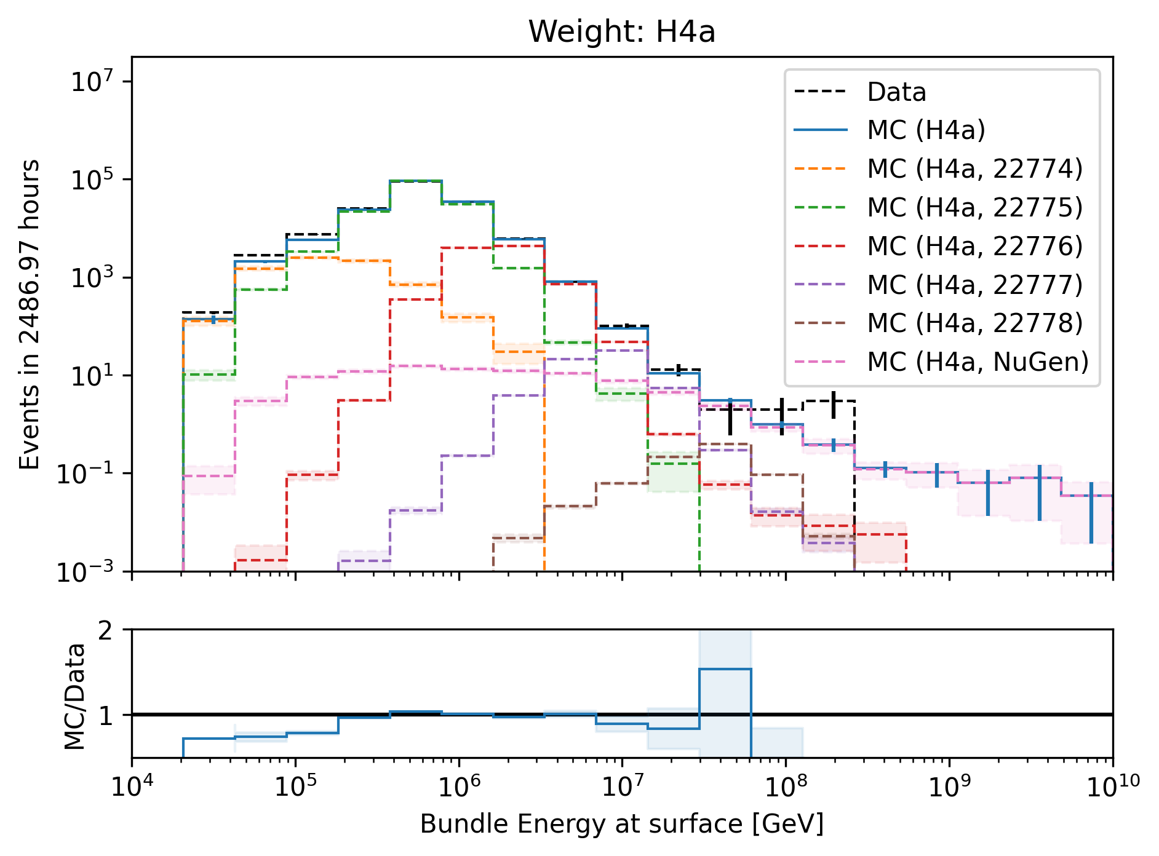
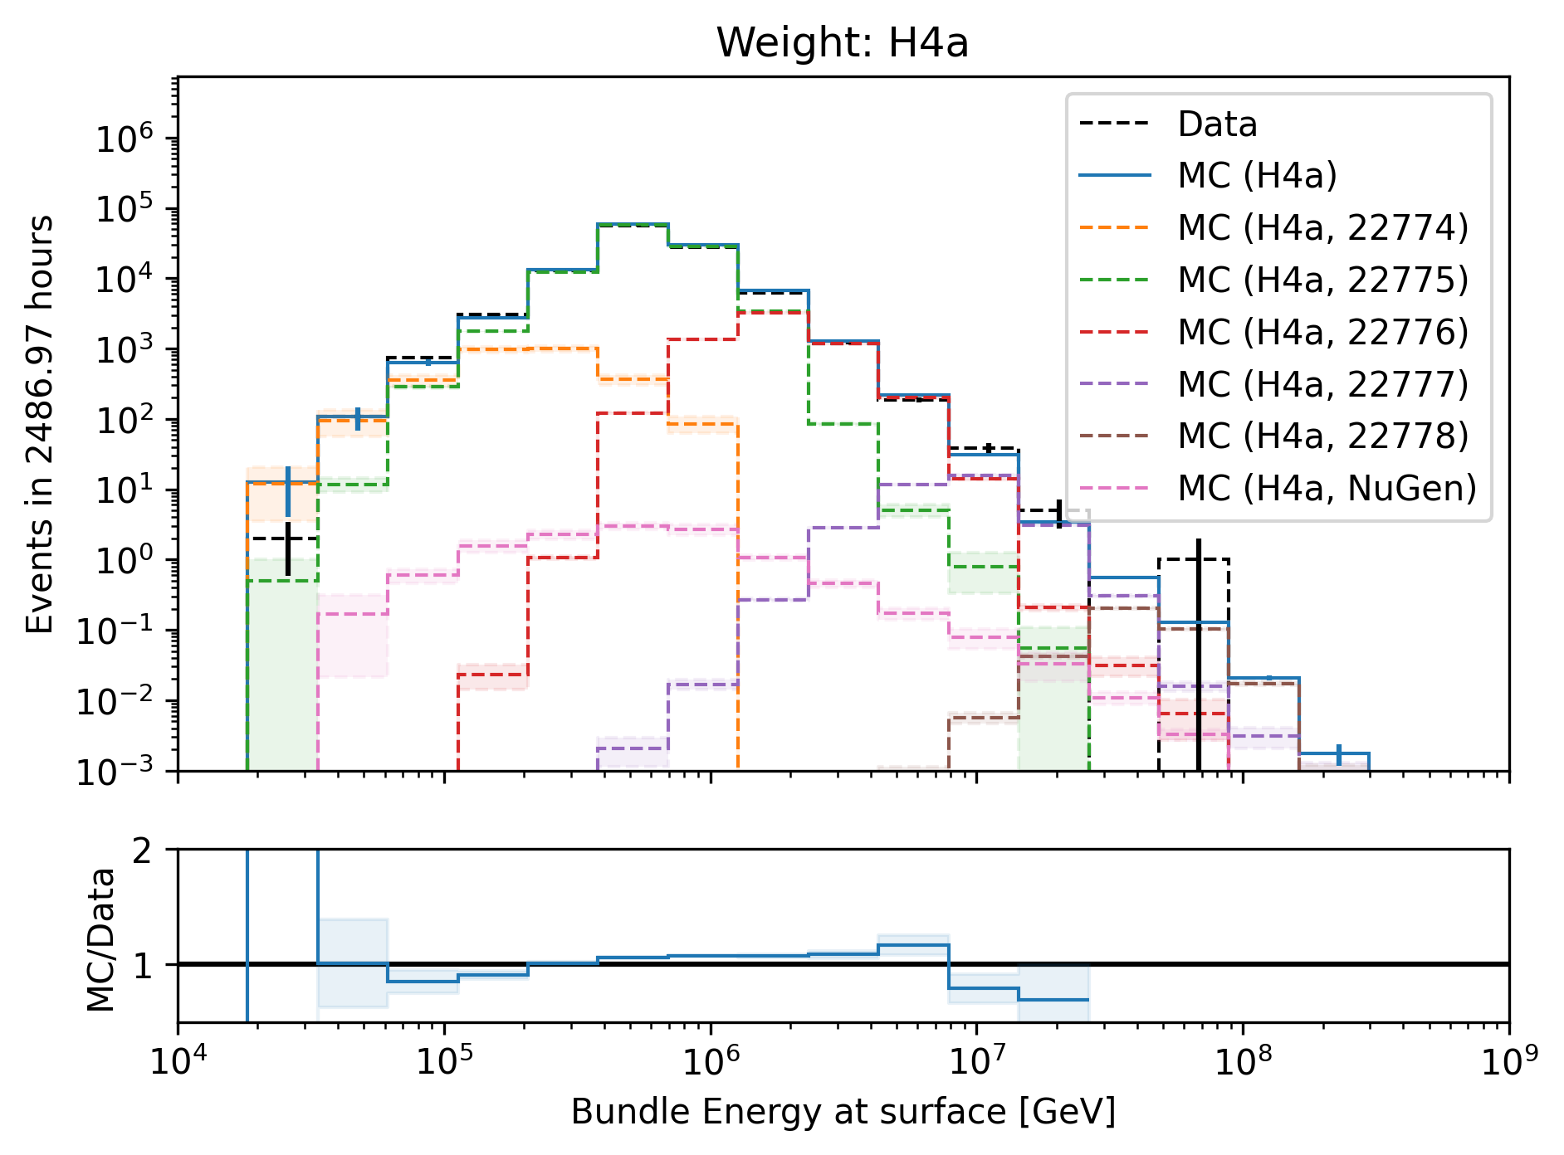
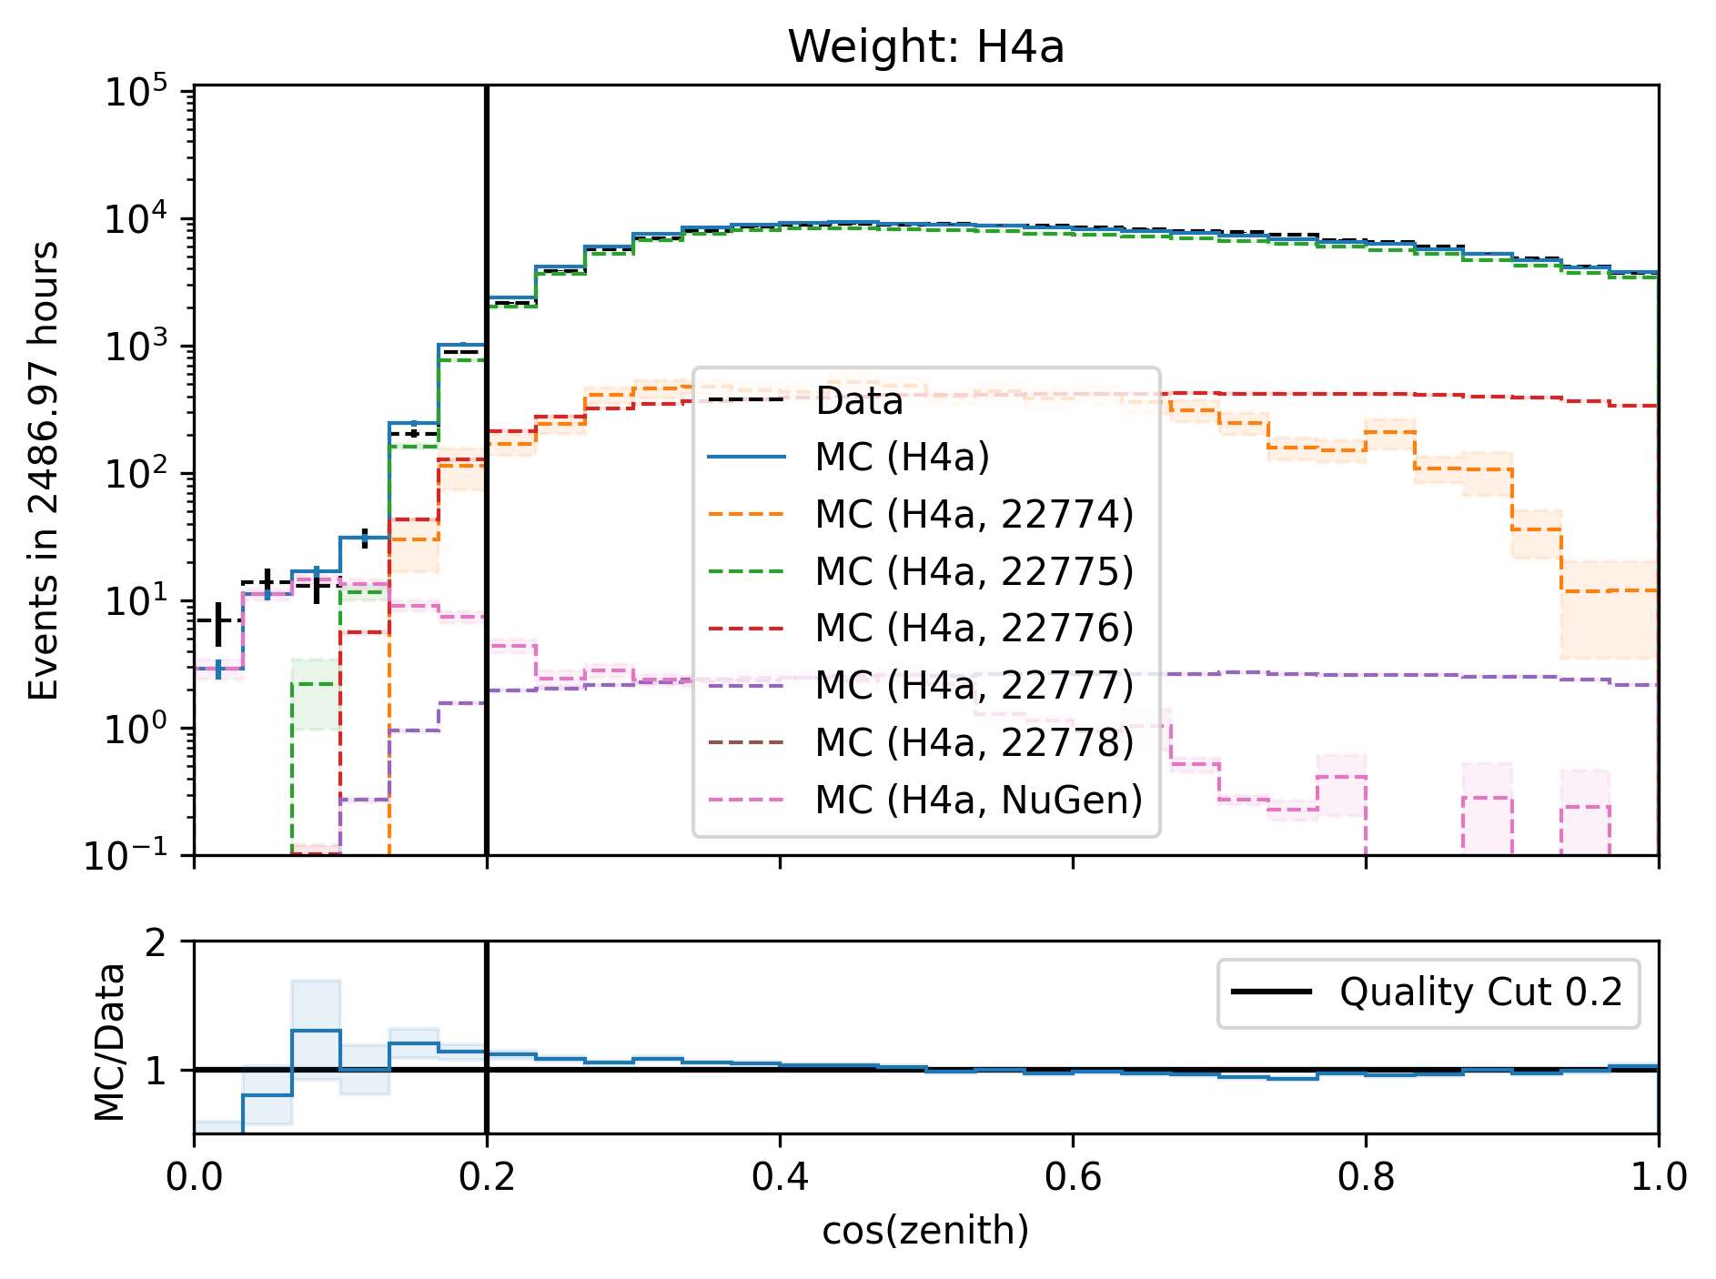
Level5: quality cuts → removes neutrinos
network learns: a high-energetic horizontal event in the detector needs a very high energy at surface

Slide 19
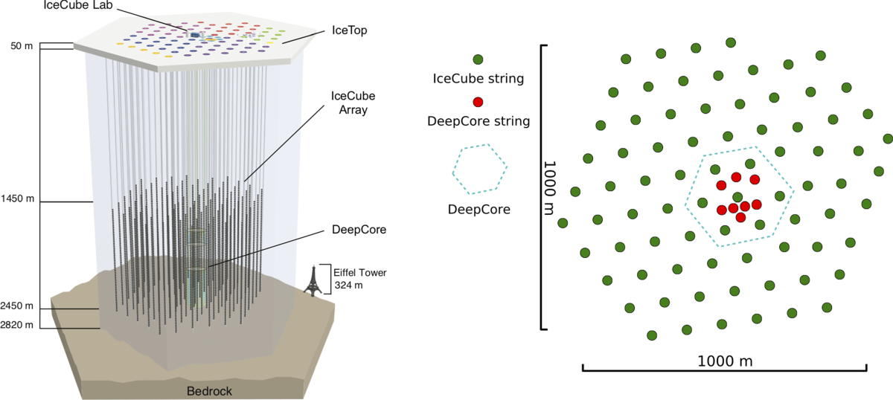
1806.05696v1

Slide 20
Analysis Goals
Measure prompt component of the atmospheric muon flux
Unfold a muon energy spectrum
Idea:
New CORSIKA simulations with extended history
Tag muons by parent → prompt or conventional
Scale amount of prompt particles
Scaling saves time and resources instead of doing multiple simulations with different interaction models
Perform forward fit of the prompt normalization
Future:
Measure prompt neutrinos
Combined muon and neutrino fit → pion/kaon ratio

Slide 21
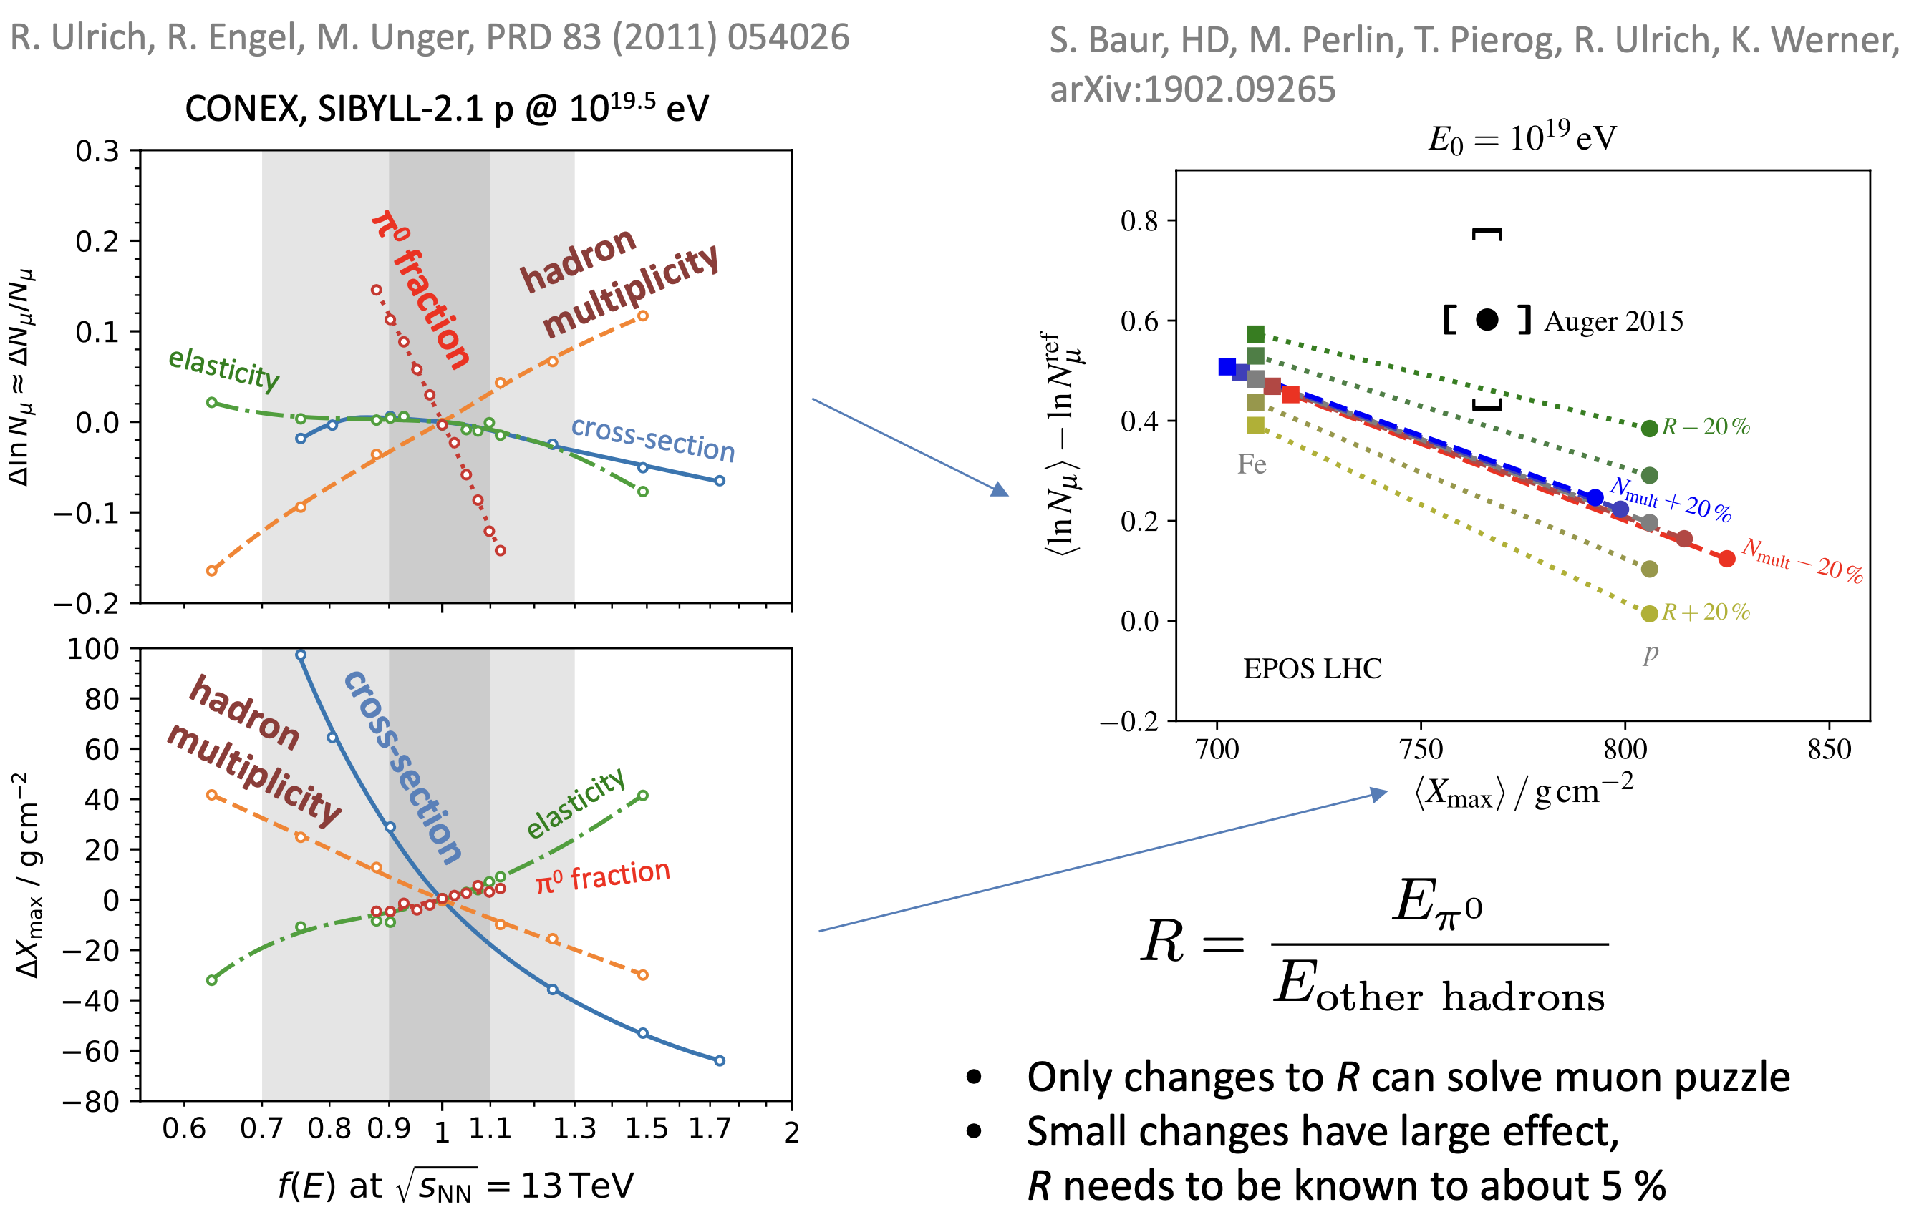
Possible Solutions
Hans Dembinski

Slide 22
Convolutional Neural Network (CNN)
Machine learning approach:
fast
identifying spatial patterns
better event reconstruction and classification
2101.11589

Slide 23
Input data per DOM
10.1088/1748-0221/16/07/P07041
3 inputs
c_{total}: Total charge
Sum of charge
t_{first}: Relative time of first pulse
Relative to total time offset, calculated as the charge weighted mean time of all pulses
t_{std}: Standard deviation of first pulse
Charge weighted standard deviation of pulse times relative to total time offset
9 inputs
t_{last}: Relative time of last pulse
Relative to total time offset, calculated as the charge weighted mean time of all pulses
t_{20%}: Relative time of 20% charge
Relative to total time offset, calculated as the charge weighted mean time of all pulses
t_{50%}: Relative time of 50% charge
Relative to total time offset, calculated as the charge weighted mean time of all pulses
t_{mean}: Mean time
Charge weighted mean time of all pulses relative to total time offset
c_{500ns}: Charge at 500ns
Sum of charge after 500ns
c_{100ns}: Charge at 100ns
Sum of charge after 100ns
Input pulses
SplitInIceDSTPulses
SplitInIceDSTPulsesTWCleaning6000ns
(DNN framework performs an internal cleaning)
Training datasets
20904
21962
22020
22187

Slide 24
Reconstructed properties
Energy
entry_energy: Leading muon energy at the detector entry
bundle_energy_at_entry: Muon bundle energy at the detector entry
muon_energy_first_mctree: Leading muon energy at surface
bundle_energy_in_mctree: Muon bundle energy at surface
Track geometry
Length: Propagation length of muon in the ice
LengthInDetector: Propagation length of muon in the detector
center_pos_x: Closest x position of muon to center of the detector
center_pos_y: Closest y position of muon to center of the detector
center_pos_z: Closest z position of muon to center of the detector
center_pos_t: Time of closest approach to the center of the detector
entry_pos_x: x position of muon at the detector entry
entry_pos_y: y position of muon at the detector entry
entry_pos_z: z position of muon at the detector entry
entry_pos_t: Time of muon at the detector entry
Direction
zenith: Zenith angle of muon
azimuth: Azimuth angle of muon
Network 1
Network 0: Muon bundle energy at surface (fast pre-cut)
Network 2
Network 3

Slide 25
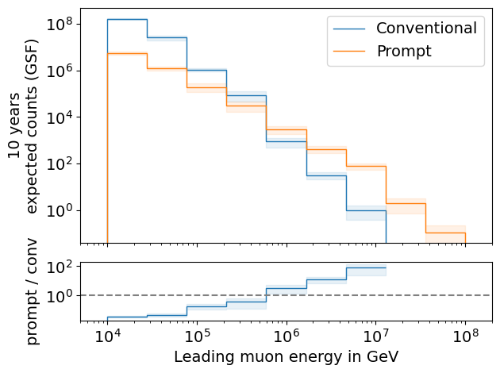
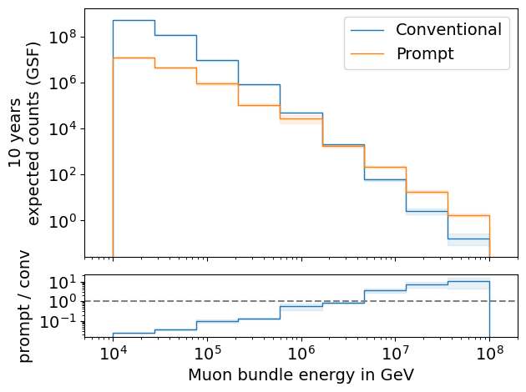
Expected Muons For 10 Years: Leading vs. Bundle Energy (GSF)
L2 MuonFilter
L2 MuonFilter
Both leading and bundle energy are sensitive to detect prompt
Leading muon energy is more sensitive

Slide 26
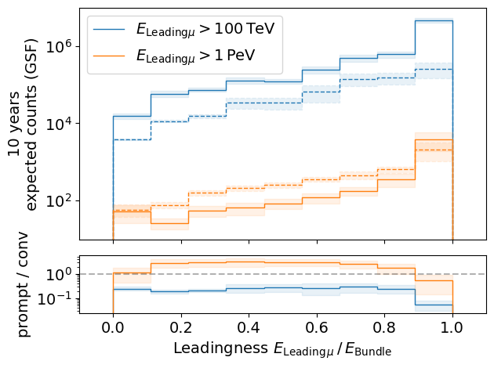
Leading Muon Energy Fraction
Solid: conventional
Dashed: prompt
Prompt dominates for energies > 1 PeV
Leading energy sweet spot: 0.1 – 0.9

Slide 27
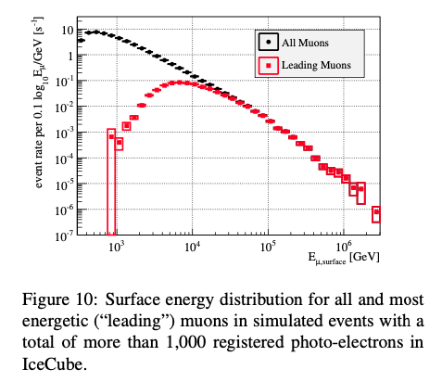
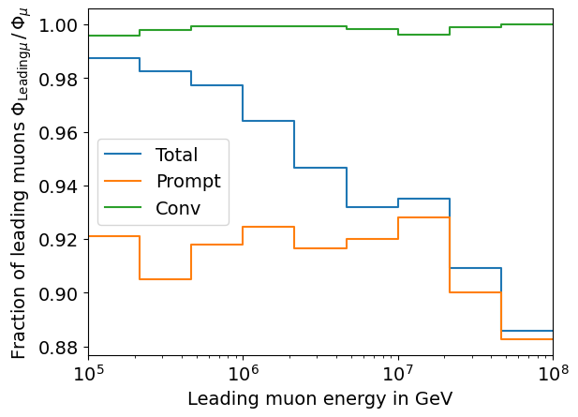
Leading Muon Contribution
Patrick Berghaus
Muons with energies between 100 TeV and 50 PeV dominate the bundle by more than 90%
In average conventional muons are more dominant than prompt
But: at high energies, there are more prompt than conventional events
High leading energy fraction does not lead to more sensitivity to detect prompt

Slide 28
Tau = 0.001

Slide 29
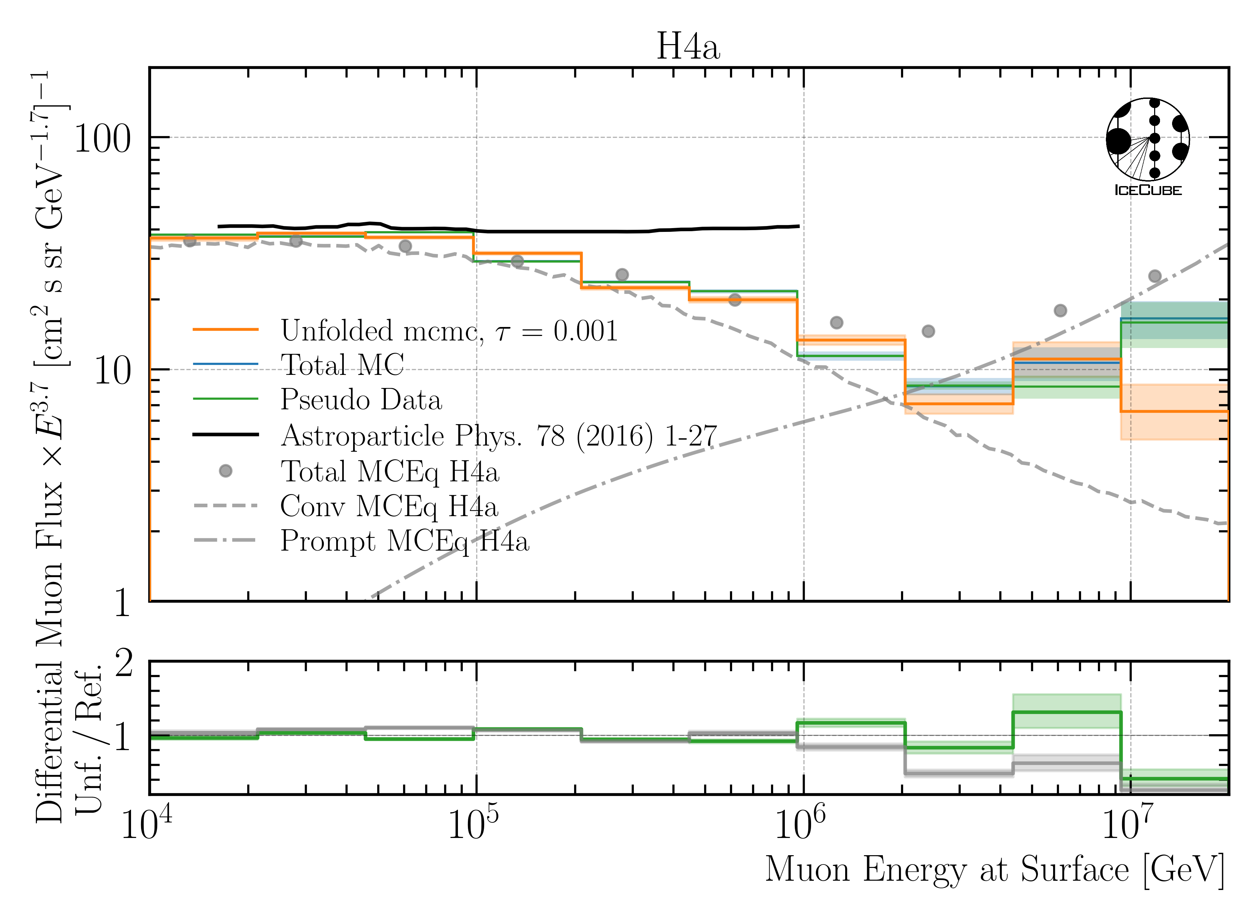
Unfolded Muon Flux at Surface

